Slide 1

Git Prepared
An introduction to GitHub
Notes:
Hub introduction before getting started
Prereqs: text editor (notepad, textedit)
Document o

Slide 2
Install Git & Choose Text Editor
Download & install Git: git-scm.com/downloads
During Windows installations select
“Use Git Bash”
“Use Unix style line endings”
If you don’t have a favorite text editor, I’d suggest Sublime Text: sublimetext.com

Slide 3
What is GitHub?
Service which hosts git repository. Specifically open source repositories for free
Provides project management tools for hosted repositories
Aims to ease collaboration in software development
Notes:
A good place to post projects you have worke on

Slide 4
Making GitHub Profile
If you don’t have, now would be a good time to create a profile.
Once you have a profile, explore GitHub for a bit e.g.
Check out what’s trending: github.com/trending
Browse some showcases: github.com/showcases
What your favorite tech company has opensourced e.g. Google
Notes:
Use whatever email
Create new if you can’t remember

Slide 5

Git
Software made for managing code, specifically made with collaboration in mind.
Keeps tracks of changes made to code
Manages merging of separate development histories
Notes:
Should I go into a model of git? Just explaining what Git add

Slide 6
Open Up Git Shell
Mac: Open Terminal
Windows: Open up Git Bash
Run git help which should display information about git

Slide 7
Inspecting What We’ve Done
Check the current status of the git repository
git status

Slide 8
Forking the Hacktoberfest Repository
Next we will fork the repository we will submit pull requests to.
Go to https://github.com/Hacktoberfest-2018/Hello-world
Press the fork button in the top right
Create a fork

Slide 9
Cloning Your Fork
Next we will create a local instance of your fork of the Hacktoberfest repository
From your fork, click the green ‘Clone or download’ button and copy the repository URL
On the command line, cd into the directory you want your repository to be in, and enter the following command:
Git clone <URL>

Slide 10
Adding your code
If you want, take a moment to write a small program in the language of choice and add it to the directory with the name of that language. If there isn’t a directory for a language you want to add, feel free to create a new directory for that language.

Slide 11
Configuring your git Credentials
Your local git repository now points to your online repository. Only a small amount of further configuration is needed.
Run the following commands:
git config --global user.name <your name>
git config --global user.email <your email address>
It’s worth noting that the email does not have to match the email used to create your Github account

Slide 12
Committing your changes
When you are finished with your program
Add the file to the list of changes which you want GitHub to track
git add .
Commit to the changes you made
git commit -m “Added some code”
Saves changes currently tracked to a version. This version can be accessed at a later time even once more changes are commited.

Slide 13
Pushing changes
Now that we have made some changes locally, we can push them to our online fork of the Hacktoberfest repository
Run the following command: git push origin master

Slide 14
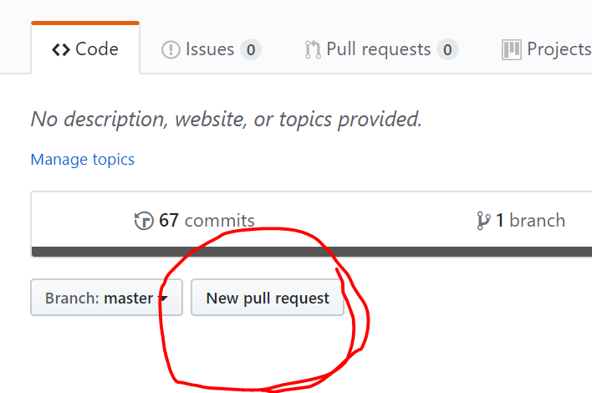
Issuing a Pull Request
Now that your remote repository reflects your changes, it’s time to issue a request that your changes be added to the main Hacktoberfest repository!
On your repository page on github and select ‘New pull request’

Slide 15
Issuing a Pull Request
Make sure you are issuing the pull request from:
YourName/Hello-world → Hacktoberfest-2018/Hello-world
When you confirm the request, it will be submitted to the maintainers of the repository for review

Slide 16
Next Steps
Now you’re all set of contribute to open source projects on Github!

